Slide 1
The Software Testing Pyramid: A Concrete Example
Jim Weaver
Vanderbilt University Medical Center
(weaver.je@gmail.com)
Source Code and Tests
https://github.com/weaverj/testpyramidexample
Selenium tests: Cindy Leffler, VUMC
Notes:
Personal intro
Hospital - testing is important
Allistair Cockburn, 1999, Cockburn scale – criticality and number of people involved. More critical = more publically visible correctness.
True for us, layers of tests with many being visible to all team members or stakeholders are important.
2009 Succeding with Agile, Mike Cohn’s Test Pyramid – how many familiar.
Not just talk about, look at implementation for an application, how to achieve.

Slide 2
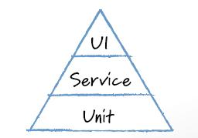
Mike Cohn’s Test Pyramid
Foundational base of unit tests
Minimum necessary tests through user interface
Service testing in the middle
Service refers to logical services – business logic, required outputs to inputs.
Notes:
Strategy of automated test distribution by purpose and type – Succeeding with Agile, 2009
Describe levels.
Follow up article by Cohn – Forgotten Layer of the Test Automation Pyramid regarding service layer
Google has similar concept for testing – Small, Medium, Large (Unit, Integration, System).
This is just one perspective and vocabulary from which to view tests – there are others (Crispin, Business Facing, Technology Facing etc).

Slide 3
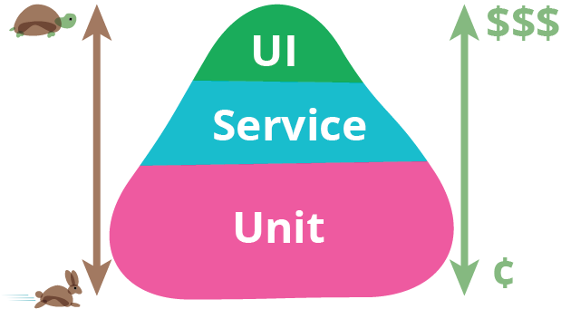
Motivations
Many teams tested primarily through the UI
Testing through UI slower, more brittle, expensive, less precise
Unit tests are easy for developers to write, usually in same language as application, locate bugs more precisely
Service level tests can test logic independent of UI
Notes:
Service level tests can be done with tools that make those tests publically visible – cucumber, fitnesse.

Slide 4

Challenges
Intentional Planning and Effort
Shared Understanding
Frequent Communication and Collaboration
Notes:
Not accident. What exact layers, what purpose, what tools, who authors, at what point in the iteration – all requies planning
Everyone on team needs to have a common understanding
Have to collaborate – avoid gaps and duplication
In addition to demonstrating a pyramid shaped suite of tests, discuss how to overcome some of these challenges as we go.

Slide 5
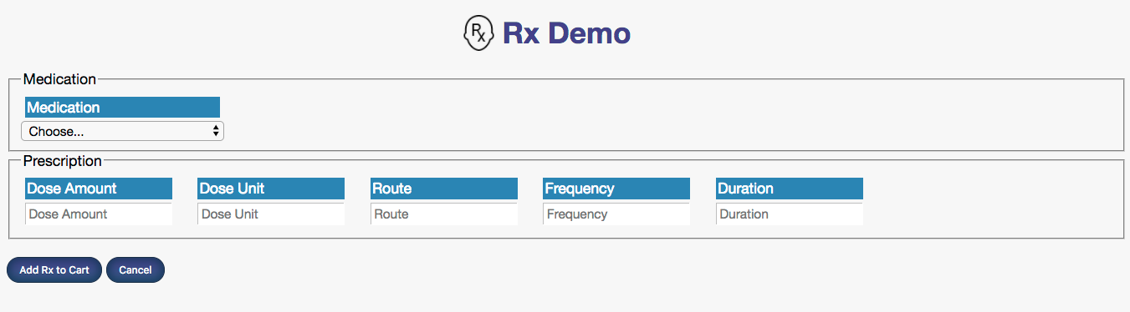
Sample Application : RxDemo
Rx Demo: Web-based Prescribing Application, extracted from real clinical app in production for over a decade.
Notes:
Look at code and test for sample application, how they fit into our intentional testing layers.
Very small but contains real world feature from real prescribing application
Web app with a back-end service layer

Slide 6
RxDemo Automated Test Strategy
 | Purpose | Authors | Tools
UI | Test UI functionality, Provides some End-End confirmation | QA automation | Junit and WebDriver to Selenium Server
Service | Test Business Logic / Outputs to Inputs | Customers (including QA) and Developers | Fitnesse
Unit | Test Units of Code, Aid with Design and Code Quality | Developers | Junit, Jasmine
Other types or dimensions of tests to consider: Performance, Integration, etc.
Notes:
- Roughly how tests were implented in the real application sample is based on
(Customers – anyone not writing production code, includes QA, BA, customers.)
Fitnesse chosen to provide high visibility of business logic tests to customers, and to drive feature development – tended to be written ahead of assigning feature to developers.
- Discussing and creating a grid of your test strategy in and of itself is useful.

Slide 7
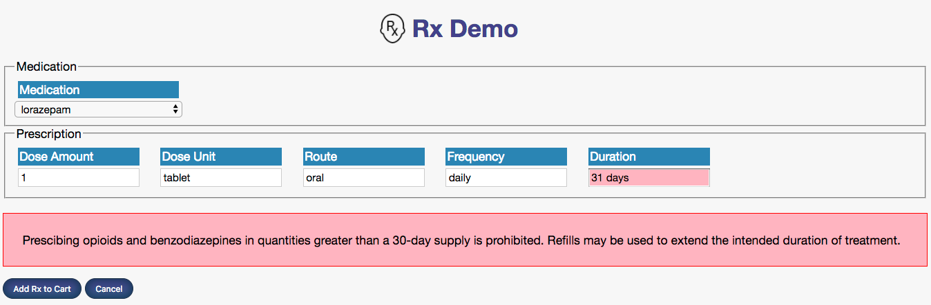
Feature: Limit Opiate Rx Duration
When clinician is prescribing Opiates or Benzodiazepines, limit the duration of the prescription to 30 days or under.
Notes:
To illustrate pyramic-style layer of tests, we’ll look at tests for a particular feature
Switch to browser and demo
- Simple feature to state, but there are a number of aspects to implement.
- What are parts we need to implement?
identify opiates
Calculate number of days from text
apply business rule based on above and inform user

Slide 8

Feature Test Plan
Feature Part | Unit (Junit/Jasmine) | Service (Fitnesse) | UI (Selenium + Junit)
Identify if drug being prescribed is Opiate or Benzo
Calculate number of days for duration
Rule applied to prescription and appropriate response built
Inform user in UI if rule violated
Notes:
Notice mini-pyramid shape for just this one feature.
UI-centric tests only needed to test UI behavior, not the business rules for identifying opiates, calculating duration, or applying the rule to a particular perscription.
Intentional distribution of tests for the feature.

Slide 9
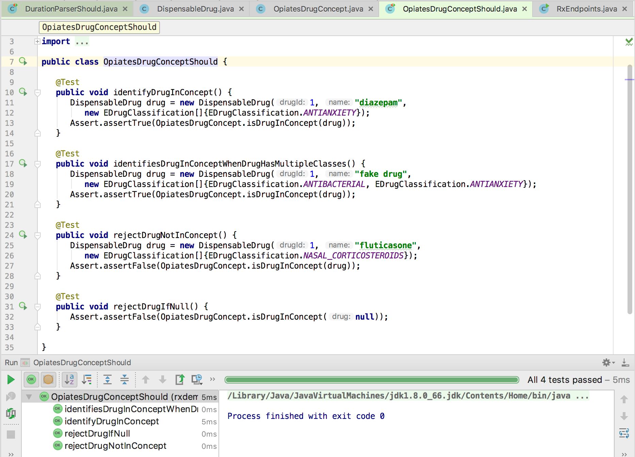
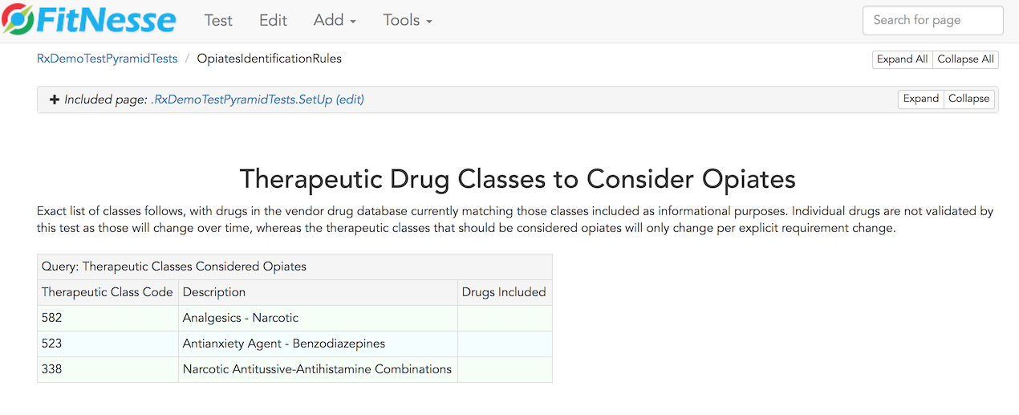
Identify Opiates / Benzos
Feature Part | Unit (Junit/Jasmine) | Service (Fitnesse) | UI (Selenium + Junit)
Identify if drug being prescribed is Opiate or Benzo
Test source
Test source
Notes:
Fitnesse tests: full spec - each drug classification that should be considered an opiate. Exact match – extra class by code fails, missing class fails.
OpiateDrugConcept is class in our system responsible for this determination, unit tests verify logic of this unit of code without duplicating information in the fitnesse tests.
<Switch to Browser/Fitnesse, Switch to Code>
OpiatesDrugConceptShould states and tests the design of the classes used to determine if a drug is in this class. DispensableDrug, EDrugClassification, and OpiatesDrugConcept classes interact to implement this feature.
Unit test is testing the design and implementation of the units of code supporting this part of the feature, fitnesse is specifying and testing the requirements for this part of the feature. There is little overlap or duplication between the tests for this reason – they complement, not duplicate one another.

Slide 10
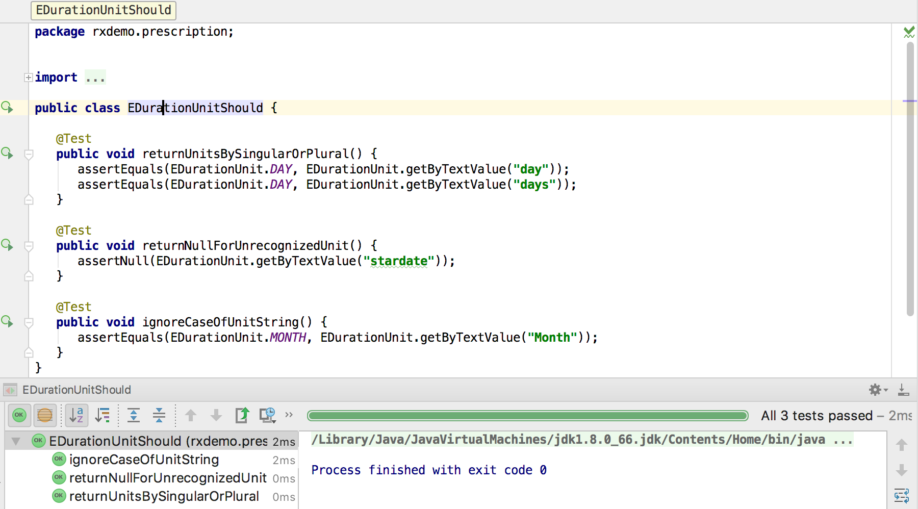
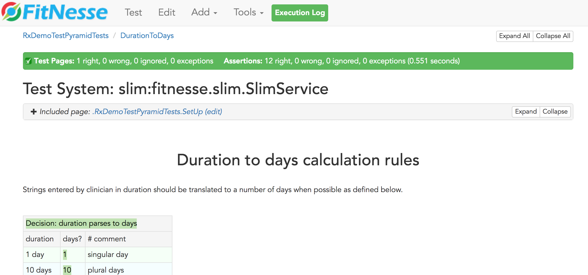
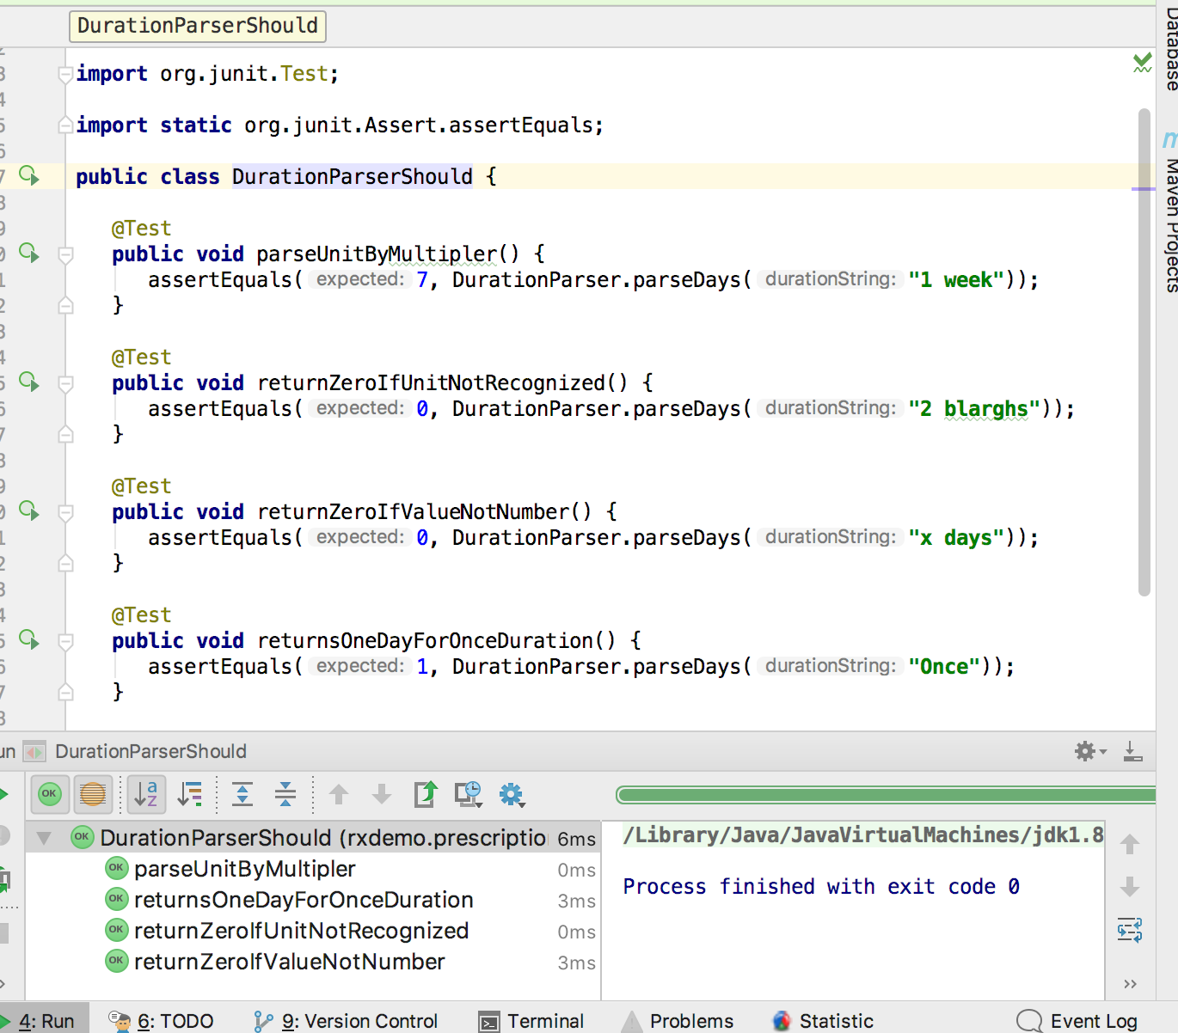
Calculate Duration in Days
Feature Part | Unit (Junit/Jasmine) | Service (Fitnesse) | UI (Selenium + Junit)
Calculate number of days for duration
DurationParserShould
DurationToDays
EDurationUnitShould
Notes:
The fitnesse test covers a wide variety of parsing scenarios.
Switch to code
Two classes provide the implementation for this part of the feature, EDurationUnit and EDurationParser. EDurationUnitShould verifies how duration units are expressed and multiplier. The test for EDurationParser covers a few of the duration calculation scenarios covered in the fitnesse test, but not the full range – small amount of overlap.

Slide 11
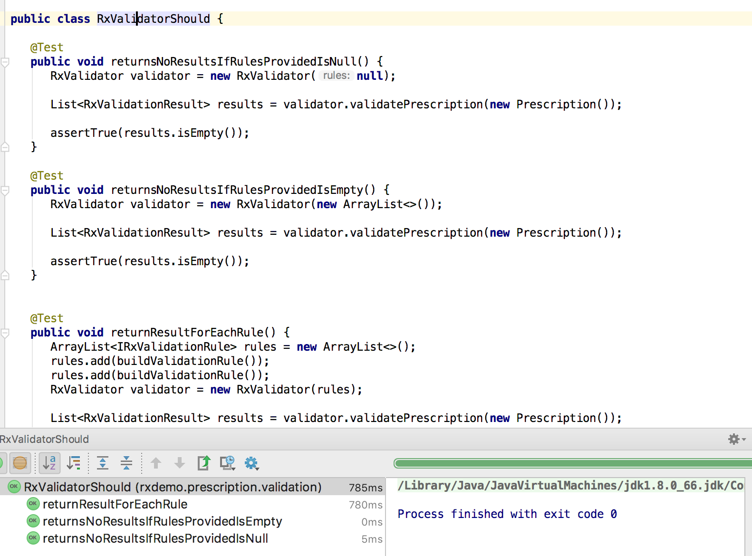
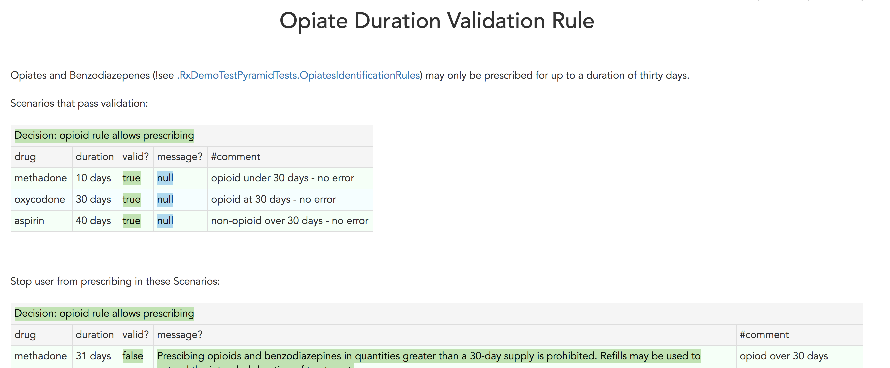
Duration Validation Rule Applied
Feature Part | Unit (Junit/Jasmine) | Service (Fitnesse) | UI
Rule applied to prescription and appropriate response built
RxValidatorShould
OpiateDurationRule
OpiateDurationValidationRuleShould
ValidatePrescriptionCommandShould
Notes:
The fitnesse test covers wide range of cases which will both pass and fail the validation rule. It relies on both opiate identification and duration parsing logic.
RxValidator is a class for running multiple validation rules, represented by IRxValidationRule interface, against a prescription. Each rule will return an RxValidationResult that indicates whether the prescription is valid with respect to that rule, and if not what message should be displayed and which prescription fields are related to the failure if any. The RxValidatorShould unit test verifies this rules runner functions correctly, but using fake rules.
ValidatePrescriptionCommand is the initial class invoked to run all prescription validation rules when a prescription is sent from a client browser. It runs all the rules and returns a response to the client. ValidationPrescriptionCommandShould tests this class with fake rules.
OptateDurationValidationRuleShould tests the validation rule used for this feature. It tests a few scenarios, including edge case like a null drug, but does not cover all business scenarios as they are covered by fitnesse test.

Slide 12
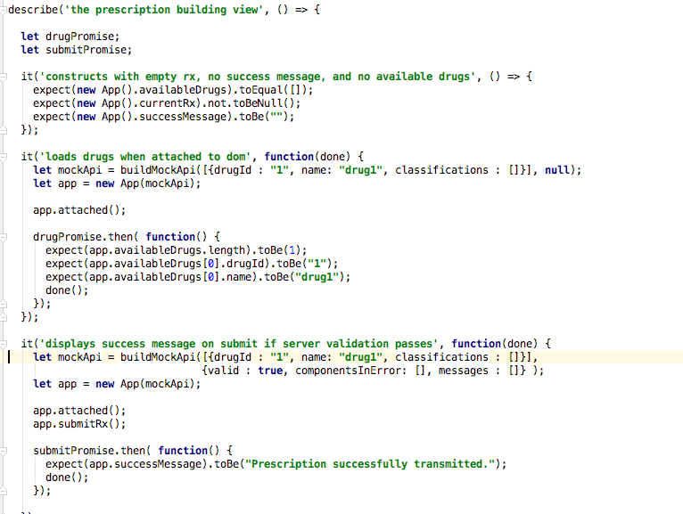
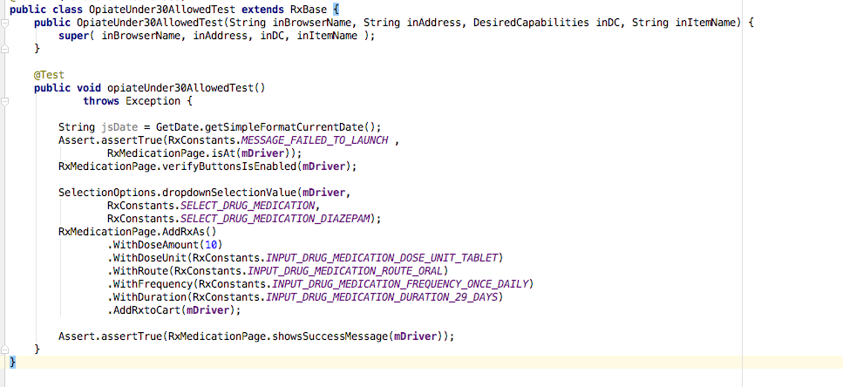
Inform User in UI if Rule Violated
Feature Part | Unit (Junit/Jasmine) | Service (Fitnesse) | UI (Selenium / Junit)
Inform user in UI if rule violated |  |  | OpiateUnder30Allowed OpiateOver30NotAllowed
RxValidatorShould
App.spec.js
RxValidationResponseHandler.spec.js
Notes:
Just two cases covered in Selenium that verify UI displays correct state when it is supposed to display a message, and when it is not.
Jasmine unit tests verify app controller state is correct based on successful and failed validation JSON responses, fields marked in error correctly
Some duplication here / success state and failure state on controller – this is also verified by Selenium tests. But the unit tests are specific to the controller code – failure of the Selenium tests could be less precise.
What if we were testing entirely through the UI? All of these scenarios covered in fitnesse and unit tests would need to be managed through UI tests – all the duration calculation scenarios, every opiate drug identified correctly, how to verify drugs aren’t included accidentally as opiates – prescribe every single possible drug?

Slide 13
Team Process and Habits
Discuss application-wide testing strategy – layers of tests, their purpose, tools, team-member responsibilities.
Keep all team members involved in all types of tests.
For each feature, explicitly discuss a test plan – what automated tests will there be at what levels?
Watch for unwanted duplication or gaps in test coverage.
When a bug hits production, don’t just fix it - find the test gap and close it.
Notes:
Specific activities that helped achieve healthy pyramidal mix of tests for the real prescribing app.

Slide 14
Questions?

Slide 15
References
Succeeding with Agile: Software Development Using Scrum by Mike Cohn, Addison-Wesley, 2009
The Forgotten Layer of the Test Automation Pyramid: Mike Cohn, 2009.
TestPyramid: Martin Fowler, 2012.
Small, Medium, Large: Mike Bland, 2011.
Methodology Per Project: Alistair Cockburn, 1999.

